Slide 1
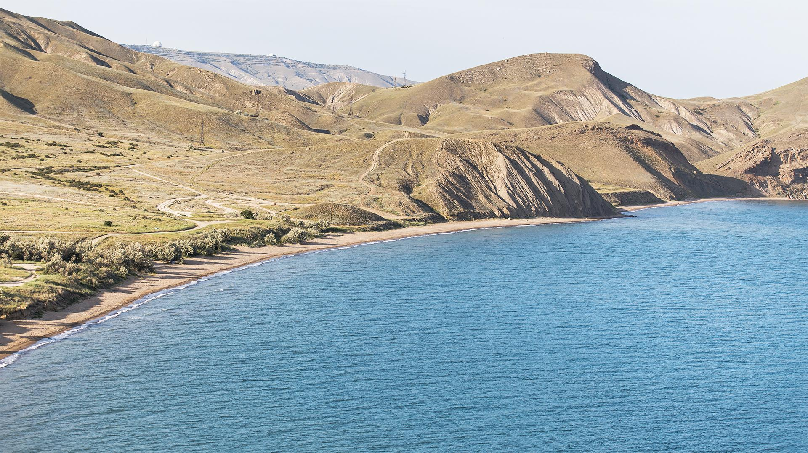
VISUALIZATION OF SHIPS AND WHALES COLLISIONS
Team 4050 – CANDEV Challenge 2022

Slide 2
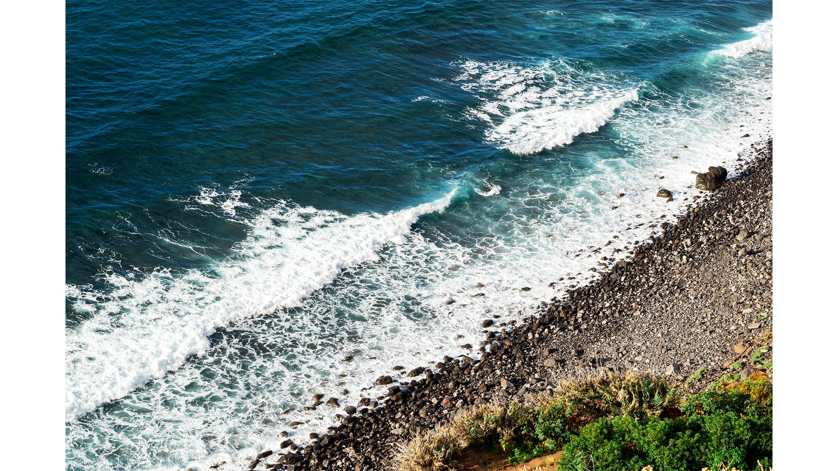
TABLE OF CONTENTS
01
BUSINESS PROBLEM
04
FUTURE EXPANSION
02
OUR VISION
05
CONCLUSION
03
MAIN OUTPUT
Identifying client’s needs
Key challenges and solutions, expanding the tool
Mapping areas of overlap
Overall achievement of the tool and meeting business needs
Demonstration of tool

Slide 3
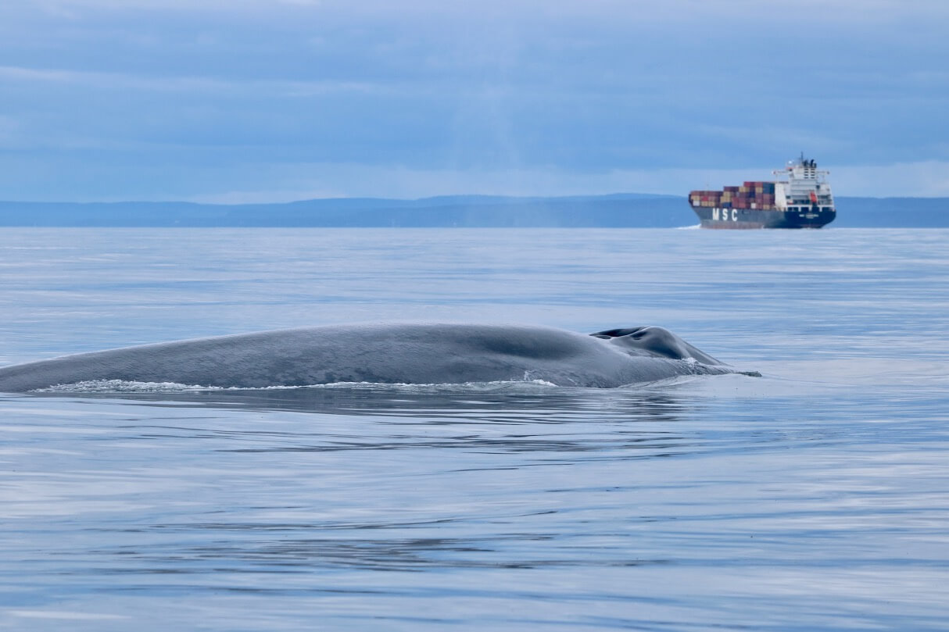
BUSINESS PROBLEM
SHIP & WHALE COLLISIONS
Ship strikes threatens life of whales
Unreported and unnoticed
PREVENTION
Preventable deaths
Tool to give insight on ship collisions with whales

Slide 4
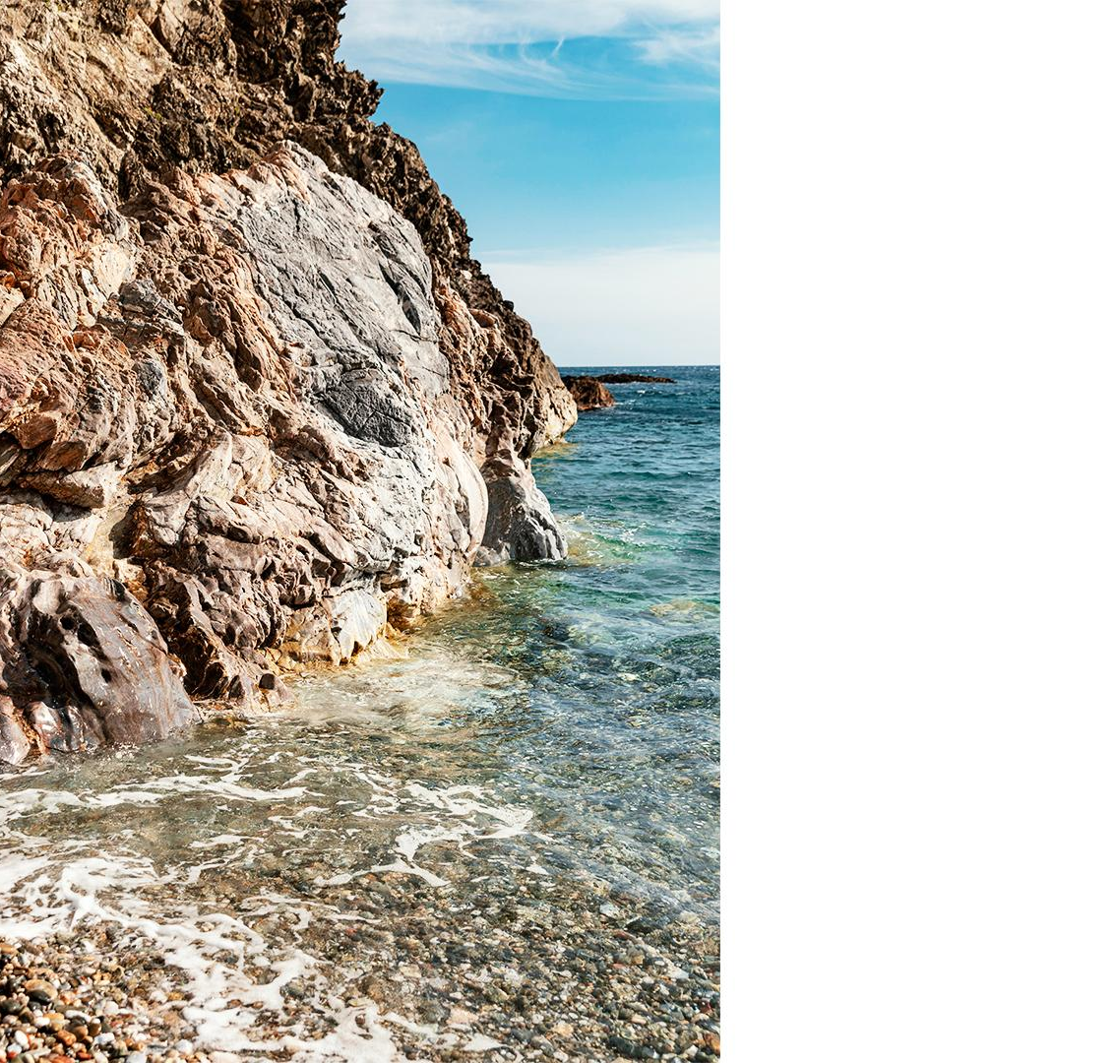
OUR VISION
To minimize unreported and unnoticed collisions
Visualization indicator of high-danger zones
Map the zones and identify areas of overlap
Rank areas of overlap by lethality
Notes:
Purpose! Why we are doing this approach: "To minimize the number of unreported and unnoticed collisions, we wanted to create a predictor which can highlight critical zones that will require extra attention".
How: Created a tool to highlight which zones that require extra attention for collisions, therefore it minimizes/reduces the number of unreported and unnoticed collisions.

Slide 5
TOOL DEMONSTRATION

Slide 6

FUTURE EXPANSION
Our Solution
Overlap areas identified
Challenges
Time filtering for slow zones
Future Steps
Heatmap to colour-code lethal zone
Expanding the tool worldwide

Slide 7
CONCLUSION
BUSINESS PROBLEM
OUR VISION
TOOLS’ CAPABILITIES
FUTURE STEPS
Tool to mitigate risks of ship & whale collisions
Identify high-danger areas to focus on
Visualization of highly probable lethal collisions zones
Capture time filters of slow zones
Notes:
Future Steps
Capturing time filters of slow zones and Expanding model worldwide and include within our tool
(because based

Slide 8
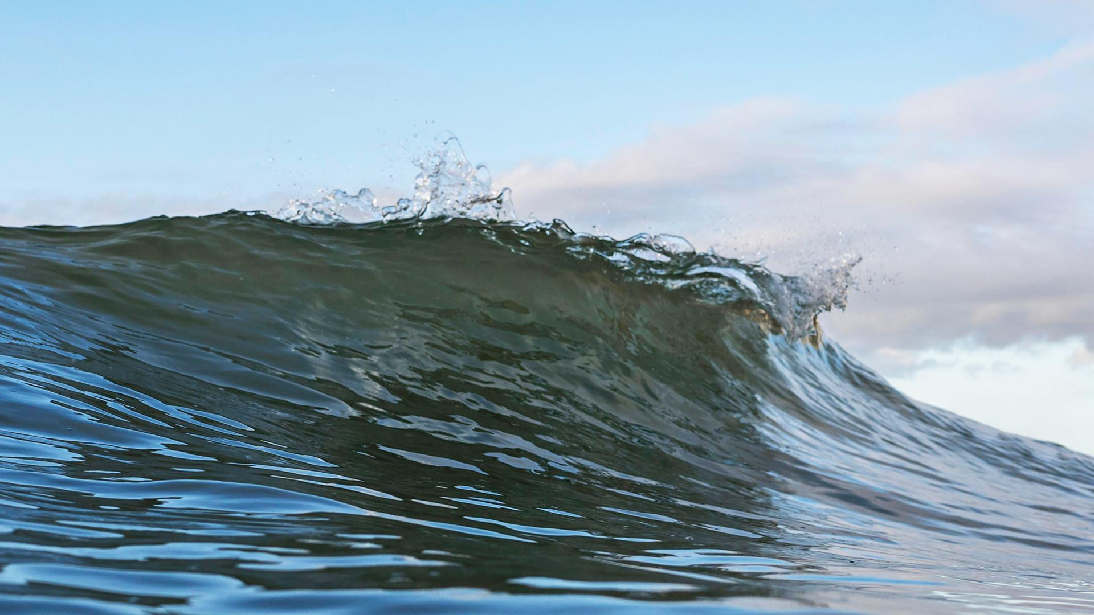
THANK YOU!
Q&A

Slide 9
Appendix A

Slide 10
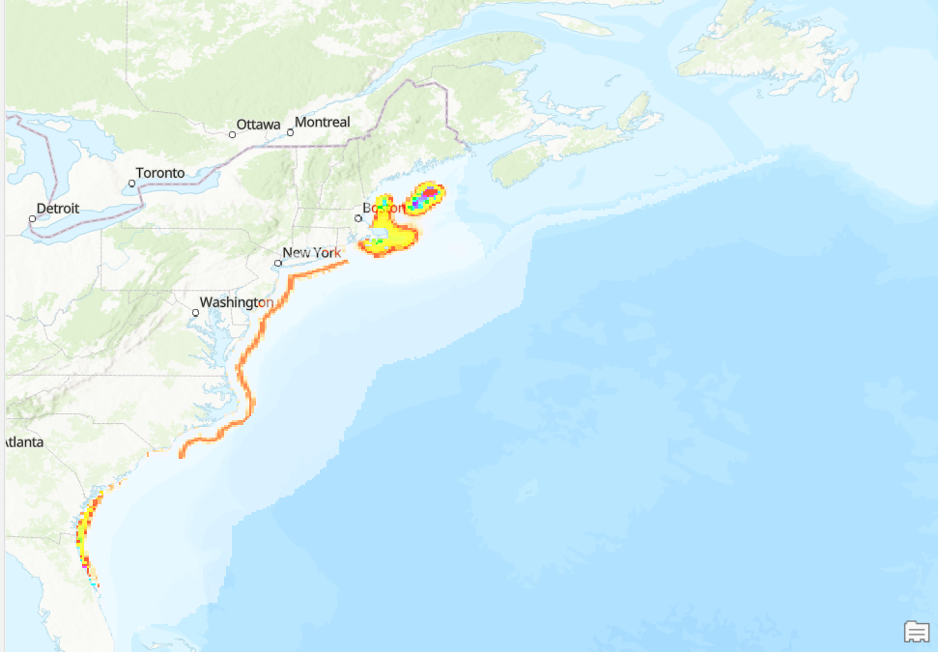
January

Slide 11
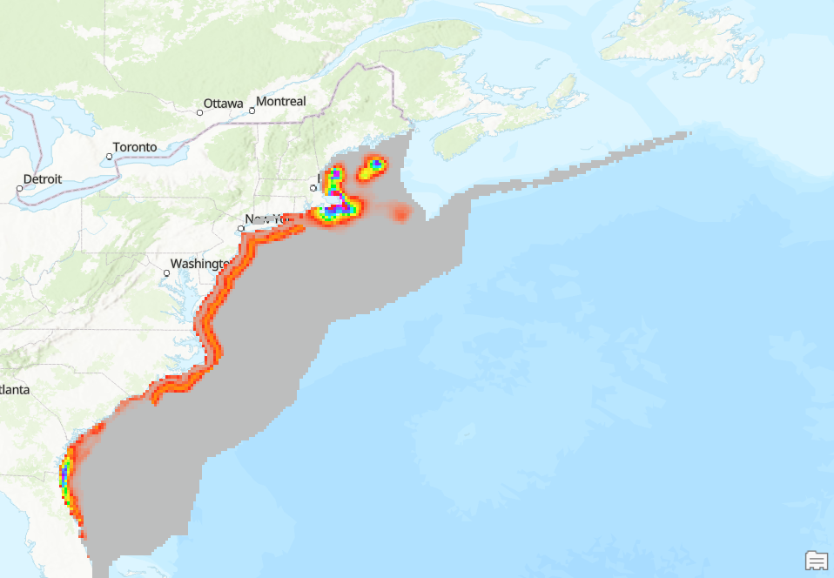
February

Slide 12
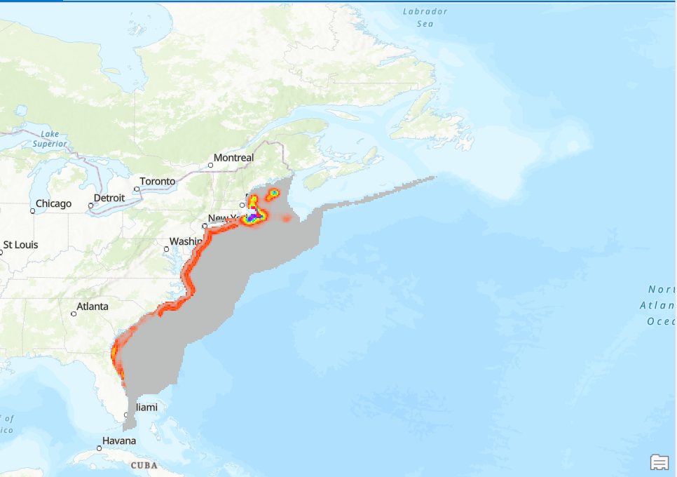
March

